Slide 1
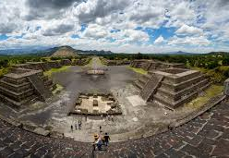
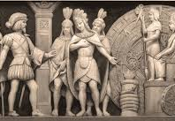
The “ Aztec Prophecy”
Linda Heredia Chavez
Professor Adrian Andrade
Mini Research Presentation
SPAN 308-90
CSUMB Spring 2020
Notes:
Good evening everyone, my name is Linda Heredia and today I will be presenting to you about the Aztec prophecy or also known as future predictions that these indigenous people had as far as the success this empire would have and their existence in the world.

Slide 2
Table of Contents:
Slide 3: Context on the 8 omens
Slide 4: Omen 1
Slide 5: Omen 2
Slide: 6:Omen 3
Slide7: Omen 4
Slide 8: Omen 5
Slide 9: Omen 6
Slide 10: Omen 7
Slide 11: Omen 8
Slide 12: Bibliography
Notes:
I will now present to you my presentation’s table of context. I will initiate with a bit of context behind this system used by the Aztec as it will provide detailed information on when and how it was used. I believe that having a section for each omen (predication) in the system used to for tale the future , is the best to do in order to fully understand each. My final slide will contain all the sources utilized to accomplish this detailed presentation.

Slide 3
Context on the 8 Omens
The civilization was striving before the arrival of the colonists.
Tenochtitlan was the center of force for the Aztec.
Their leader Montezuma II was the first to know of their end
Use of system (omens) to understand the world
Spanish Franciscan friar Bernardino de Sahagun ( book: The Florentine Codex)
Notes:
The Aztec empire was considered a very strong and striving civilization. Aztecs were perceived as a very dominant tribe. From there arrival to Mesoamerica and from their magnificent capital, Tenochtitlan, they were the force who controlled an immense capacity shown in the systems of social, political, religious and commercial organizations. Among many of the skills that distinguished them from the rest, one of them was their agricultural systems, excellent when in time of cultivation and irrigation, creating them the prosperous empire that they were.
As leader of this tribe, Montezuma II had the ability to witness these 8 signs that were later titled as omens. The signs are said to be the predications of what was going to happen to the empire, years before the arrival of the colonist. When the colonists did arrive and began to destroy the empire, those 8 signs applied to the process of how slowly they were facing their ending time. This use of system to understand the world and comprehend certain atrocities that would occur were first known, after friar Sahagun published about them in his book The Florentine Codex. His book contained a description of what each omen was and how they would end the empire.

Slide 4
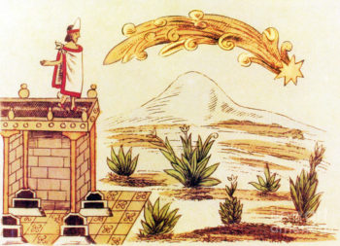
Omen 1
Ocurres in 1509
10 years before the arrival of the foreign invaders
Notes:
This omen was said to appear on one very dark night, which illuminated the sky as it was in a form of a fire plume now in modern days described like a falling star. The name given to this omen was known to be “ the sky omen”. This omen lightened up the sky for the Aztec’s almost a year and allowed almost no possibility of having a dark normal night. The unknow origin of this item provoked a lot of fear in the civilization and made its way to be recreated in the Aztec calendar, falling under the year of its appearance 1509.

Slide 5
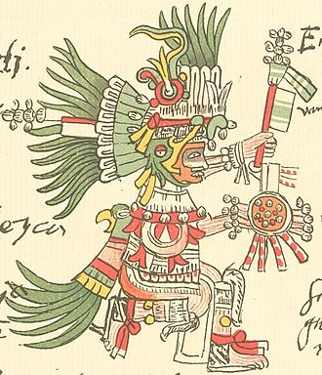
Omen 2
Destroyed the temple of Huitzilopochtli
This omen left the Aztec without a protector and guidance
Notes:
This omen was said to appear in the form of fire. The fire that sparked out had no originator and it happened to be in the temple of one of the Aztec’s Gods. The temple of Huitzilopochtli was destroyed as the flames burned it down to the ground. The results of this fire, left the Aztecs to feel fear and danger, since they were no longer having protection or guidance towards a more prominent future.

Slide 6
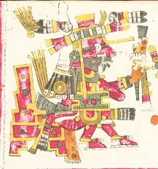
Omen 3
Destroyed the temple of Xiuhtecuhtli
This omen left the Aztec with no god of fire
Notes:
This omen was said to also appear in the form of fire. However, this fire destroyed a different temple, that time being the temple of the god of fire. Xiuhtecuhtli was essential in the lives of the Aztecs because it provided fire and was also associated to the young warriors and rulers of the empire.

Slide 7
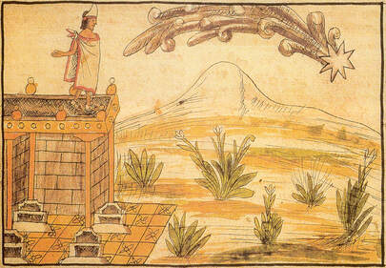
Omen 4
Falling star (meteors)
Spread from west to east in the sky of central Mexico
Notes:
This omen is said to have been just like the first one. The first omen appeared in a form of a falling star, but for the Aztec it was an unknown and mysterious falling fire ball from the sky. After the analysis of this item's appearance in the sky, experts were able to identify both omens just as simple meteors falling from the sky. However, the Aztec people did not have the know of such happenings, therefore, in both events they caused panic.

Slide 8
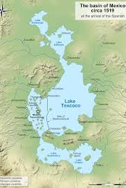
Omen 5
Caused Lake Texcoco, to overflood
Submerged underwater buildings built near the shore and tossed boats off usual paths
Notes:
The description given of this omen was that it caused the lake to overflood causing some modern damage to the building and surroundings. The reason why the overflood was considered an omen was because the Aztec had no clue in the possibilities of lakes having this type of turnouts after heavy rain or climate changes, therefore it was foretelling the severe damage expected to come later in the future.

Slide 9
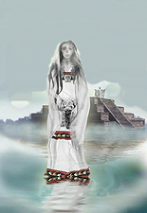
Omen 6
The weeping woman (La Llorona)
A cry that lead to be heard for days
Believed to be the goddess Coatlicue
Notes:
For this omen, the form of its appearance was through a cry that came form a women. The women had been described to be a variety of feminine figures, but the one that entitled the culture of Aztec is that she represented their goddess Coatlicue. The cry was said to be heard for many nights and without any clue why, it was just a haunting and terrifying cry that was accompanied by these words, “My children, it is already to late”. The Aztec believed that this was an omen sent to warn them of the disasters awaiting them.

Slide 10
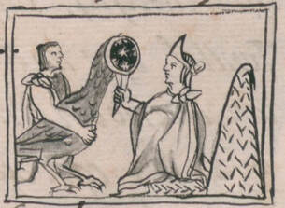
Omen 7
Found inside fisherman’s nets
Located in Lake Texcoco
Notes:
This omen was said to appear in the form of a bird, a very extravagant and unusual one. The description given of this unique creature was that, it had a flat and reflective surface on his head, like a mirror and had unusual colors all over his feathered body. This creature was taken to be owned by the emperor Montezuma II, as he accustomed to collect these one of a kind creatures. When Montezuma was left alone to examine the bird, he saw a reflection on the mirror of men marching down with weapons, which was unknown to him. Shortly after, he called others to view the image, but it disappeared and then the bird died. This was seen a very bad sign.

Slide 11
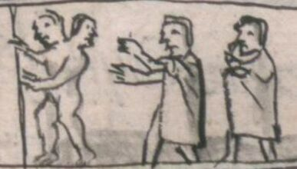
Omen 8
The two headed monster
Disappeared after it was shown to Montezuma II
Notes:
This omen was said to be the last sign to appear shortly before the arrival of the colonist. The form of this omen was of a creature with two heads and unique in its type. The discovery of this creature was shared with the emperor, but just like the 7th omen, it despaired after glancing over it for a short period. This omen was the one to have been the last warning of the terrible timing to come.

Slide 12
Bibliography
Bitto, R. (2017, June 11). The 8 Omens of Montezuma and the End of the Aztec Empire. Retrieved from http://mexicounexplained.com/8-omens-montezuma-end-aztec-empire/
Cartwright, M. (2013, August 22). Xiuhtecuhtli. Ancient History Encyclopedia. Retrieved from https://www.ancient.eu/Xiuhtecuhtli/
History.com Editors. (2009, October 27). Aztecs. Retrieved from https://www.history.com/topics/ancient-americas/aztecs
Writers, H. C. (2018, August 15). Aztec Omens. Retrieved from https://www.historycrunch.com/aztec-omens.html#/
Notes:
This slide contains the resources I used to complete this presentation. Thank you very much.

